Slide 1

Smart Vision: Attendance Marking System using CNN
BY : PRANHSU SAINI (E22CSEU1300)
PRATHAM AGARWAL (E22CSEU1308)
SALONI TYAGI (E22CSEU1320)

Slide 2

Why Choose a Smart Attendance System?
Traditional Methods Issues
Time-consuming and error-prone
Prone to proxy attendance
Require physical contact
Benefits of Smart System
Contactless and automated
Real-time logging via CCTV
Increased accuracy and security

Slide 3

Deep Learning & CNNs in Face Recognition
CNN Strengths
Popular Techniques
Learn facial patterns robustly over multiple layers
FaceNet: Triplet loss & GoogleNet
ArcFace: Angular margin loss
SphereFace and CosFace variants
Performance
Achieves up to 99% accuracy on benchmark datasets

Slide 4
System Architecture Overview
Input
Processing
Output
Live CCTV video feed capturing faces
Face detection
Attendance records exported to Excel
Landmark extraction (eyes, nose, mouth)
Feature embedding
Classification and matching

Slide 5
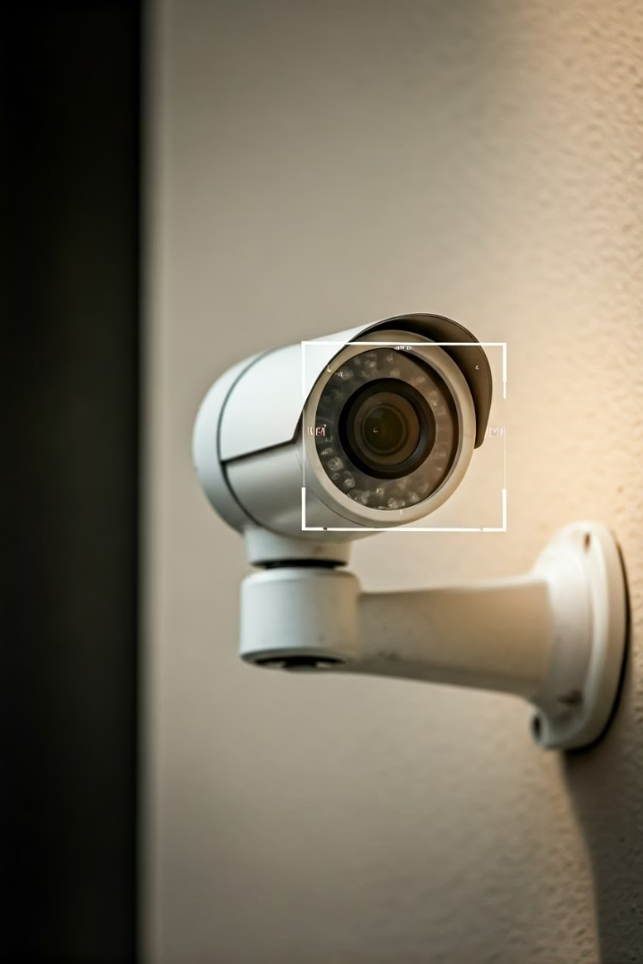
Data Collection & Preprocessing
Data Sources
Preprocessing Steps
Real-time CCTV feeds and manual image uploads
Convert images to grayscale
Detect and crop faces to remove background
Resize images to 128x128 pixels
Normalize pixel values
Purpose
Ensure consistent input for model training and accuracy

Slide 6
Model Training & Recognition Techniques
Models Used
Training Process
Outcome
Deep Neural Networks (high accuracy)
CNN extracts key facial features
Real-time identification with high accuracy
Backpropagation reduces errors
MTCNN for face detection & alignment
Model saved in .h5 or .pkl format
Haar Cascade for fast lightweight detection

Slide 7





Attendance Workflow & Key Features
Step 1
Capture live video feed from CCTV
Step 2
Detect and align faces in frames
Step 3
Extract facial features using CNN
Step 4
Match features with database (≥85% similarity)
Step 5
Log attendance with timestamp and confidence

Slide 8
Excel Integration & User Interface
Excel-Based Records
Web UI Features
Stores name, confidence score, timestamp
Start and monitor live attendance
Supports filtering and sorting
Register new students via image upload
Portable and easy to share
View and edit attendance records
Mobile-friendly and real-time updates

Slide 9

Future Enhancements for Scalability
Multi-Factor Authentication
Combine face recognition with RFID or fingerprint
Cloud Storage Integration
Sync attendance data with cloud platforms
Liveness Detection
Detect blinking and depth to prevent spoofing
AI Upgrades
Use Vision Transformers to enhance speed and accuracy

Slide 10

Key Takeaways & Next Steps
Smart Attendance Benefits
System Strength
Powered by CNNs with real-time face recognition
Automated, accurate, contactless, and secure
Next Steps
Implement enhancements like multi-factor auth
Expand cloud sync and UI improvements
Explore advanced AI models for better performance

